Slide 1
Weather Conditions and Climate Change Analysis with ClimateWins
ANDY CEN

Slide 2
Contents
Project Goals
Hypotheses
Data Set
Data Ethics
Data Optimizations
Algorithms
Summary
Next Steps

Slide 3
Project Goals
Goal: ClimateWins is interested in using machine learning to help predict the consequences of climate change around Europe and, potentially, the world.
Motivation: ClimateWins has been sorting through hurricane predictions from The National Oceanic and Atmospheric Administration (NOAA) in the U.S., typhoon data from The Japan Meteorological Agency (JMA) in Japan, world temperatures, and a great deal of other data.
Objective: In this project, I will use machine learning to help predict the consequences of climate change while working as a data analyst at a European nonprofit organization.

Slide 4
Hypotheses
The accuracy of weather predictions will vary depending on the geographic location, as climate conditions differ from each region.
Machine Learning Algorithms can accurately predict future weather conditions.
Extreme weather events, which have increased over the past 10 to 20 years, can be predicted and planned for using advanced tools like machine learning.

Slide 5
Data Set
Date Range
Data is collected from the late 1800s to 2022.
Data Collection
Data is collected by the European Climate Assessment & Data Set Project.
Data is Based on weather observations from 18 different weather stations across Europe
Data Geography
Data consists of wind speed, temperature, global radiation, and more.
Data Content

Slide 6
Data Biases
Privacy and Ethics: Using location data in climate change models requires caution to avoid unintentional exposure of personal information.
Regional Bias: Data from one region may not apply universally, so diverse regional datasets are necessary to avoid skewed predictions.
Human Bias: Bias in data collection or reporting could influence machine learning models, leading to inaccurate predictions.
Data Quality: Incomplete or biased data can result in incorrect weather predictions, making supervision and diverse data essential for accurate forecasts.

Slide 7
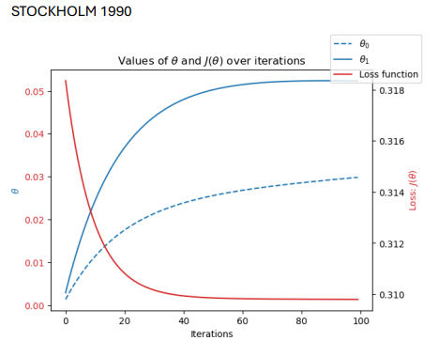
Data Optimization
This data set was optimized through Gradient Descent.
One of the simplest ways to find a local minimum (or valley), as well as one of the most common.
Adjusts the parameters to reduce a loss function to its minimum
Can be used in both linear and nonlinear cases.

Slide 8
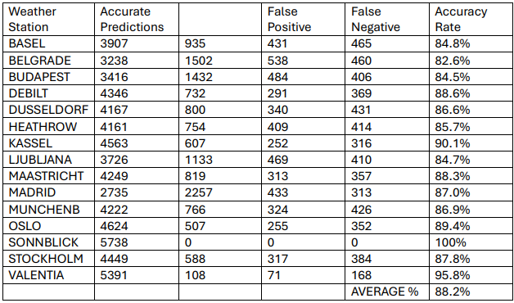
K-Nearest Neighbors
KNN classifies data based on the majority class of its nearest neighbors.
Used to predict pleasant weather in 15 European stations.
Achieved 88.2% average accuracy.

Slide 9
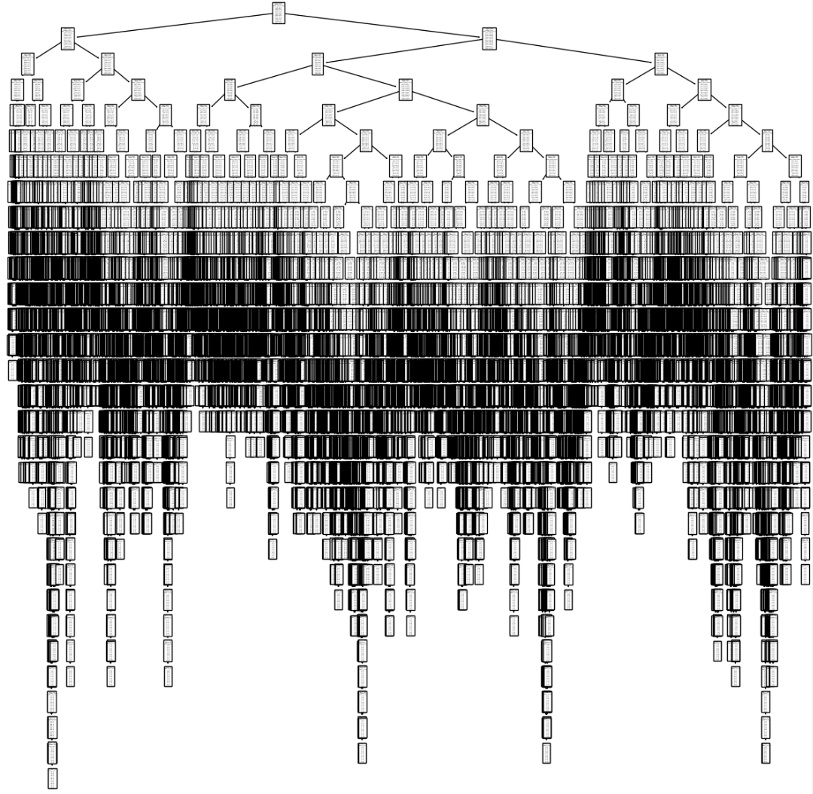
Decision Tree
The decision tree algorithm classifies data by branching based on features, ending at a classification leaf.
Used to predict pleasant weather in 15 European stations with 46.1% train accuracy.
Likely overfitting; pruning may improve accuracy.

Slide 10
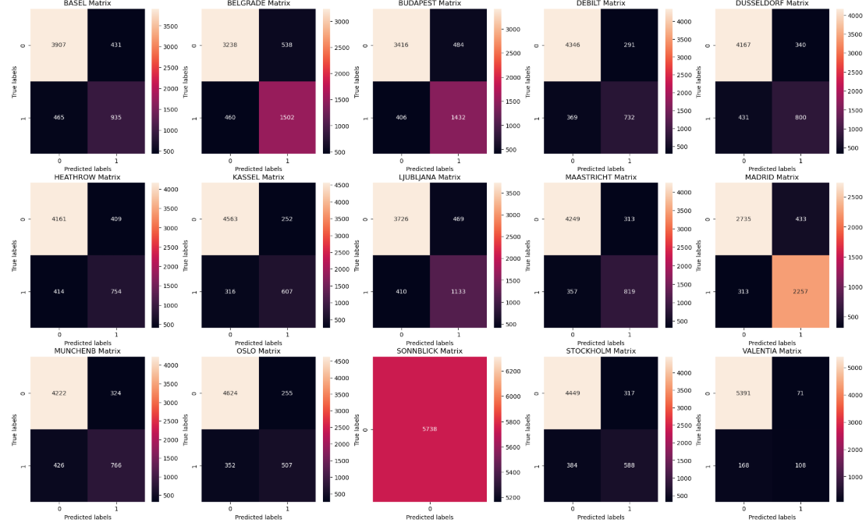
Artificial Neural Network
ANN mimics the brain using layers of interconnected neurons to learn patterns.
Learns by adjusting neuron connections; optimized via parameters like iterations, layer size, and learning rate.
Achieved a highest test accuracy of 67%.
Notes:
This is a series of confusion matrices. Each matrix represents accurate predictions of unpleasant days (upper left), inaccurate predictions of unpleasant days (upper right), inaccurate predictions of pleasant days (lower left), and accurate predictions of pleasant days (lower right). Each weather station has its own matrix. Notice Sonnblick’s solid matrix, which represents the ANN’s 100% accuracy in predicting only unpleasant weather days for this location.

Slide 11
Best Algorithm for ClimateWins Analysis
The decision tree needs further pruning for more accurate predictions.
The K-Nearest Neighbors Algorithm had the highest accuracy of 88.2% for predicting the climate temperature.
The Artificial Neural Network had a test accuracy of 67% after 3 tests.
The ANN model allows for more complexity in its analysis which sets it apart from the KNN model.
I believe that with further tests and adjustments with more added variables, the ANN would be the better algorithm.

Slide 12
Summary
The accuracy of weather predictions does vary depending on the geographic location, as climate conditions differ from each region.
Sonnblick had 5,738 accurate predictions whereas Basel only had 3,907 accurate predictions.
Machine Learning Algorithms can accurately predict future weather conditions.
KNN had an average accuracy of 88.2%
Extreme weather events, which have increased over the past 10 to 20 years, can be predicted and planned for using advanced tools like machine learning.
With high accuracies from the ANN and KNN models, it is safe to say that extreme weather events can be predicted using machine learning.

Slide 13
Next Steps
Diversify variables other than temperature to find more insights and trends.
Incorporate more weather stations to expand machine learning capabilities.
Continue to run further tests and make adjustments and improvements to bolster model accuracies.

Slide 14


Thank you!
For any further questions, please contact me at my email
Check out my GitHub for the Python scripts and datasets used in this analysis
andycen7@gmail.com
GitHub Link

